Slide 1
RESEARCH agent
CAPSTONE PROJECT
Presented By: Nirbhay Kumar
Student name : Nirbhay Kumar
College Name & Department : CSE

Slide 2
OUTLINE
Problem Statement
Technology used
Wow factor
End users
Result
Conclusion
Git-hub Link
Future scope
IBM Certifications

Slide 3
Problem Statement
A Research Agent is an AI-powered assistant designed to streamline academic and scientific research. It uses Natural Language Processing (NLP) to understand research queries, search and summarize relevant literature, and organize references efficiently. This agent can also assist in drafting research content, generating hypotheses, and managing citations—saving significant time and effort. By automating repetitive research tasks, it enhances productivity and fosters innovation in R&D. Technology Used: Integration of IBM Cloud Lite services and IBM Granite AI models is mandatory for building the Research Agent.

Slide 4
Technology used
IBM cloud lite services
Natural Language Processing (NLP)
Retrieval Augmented Generation (RAG)
IBM Granite model

Slide 5
IBM cloud services used
IBM Cloud Watsonx AI Studio
IBM Cloud Watsonx AI runtime
IBM Cloud Agent Lab
IBM Granite foundation model

Slide 6
Wow factors
Semantic Search: Finds relevant academic content from papers and datasets.
Smart Summarization: Simplifies complex research into digestible insights.
Citation Mapping: Shows relationships between cited works and academic influence.
Topic Recommendations: Suggests related papers and authors based on current research interests.
Keyword Trends: Tracks how research terms evolve over time.
Collaboration Discovery: Identifies potential research partners and institutions

Slide 7
End users
Academic Researchers
Research Institutions and Universities
Industry R&D Teams
Educators

Slide 8
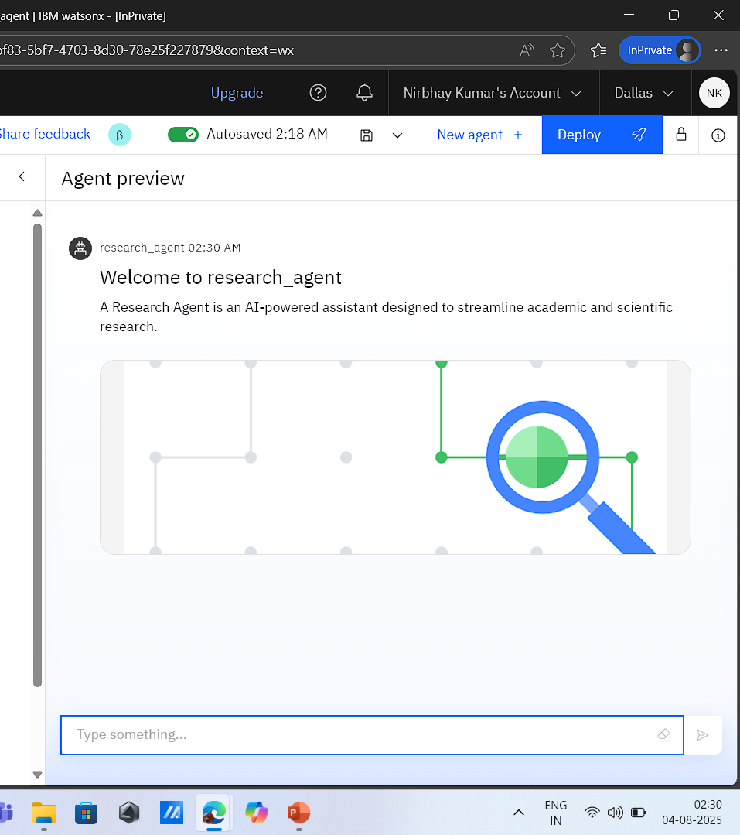
Results

Slide 9
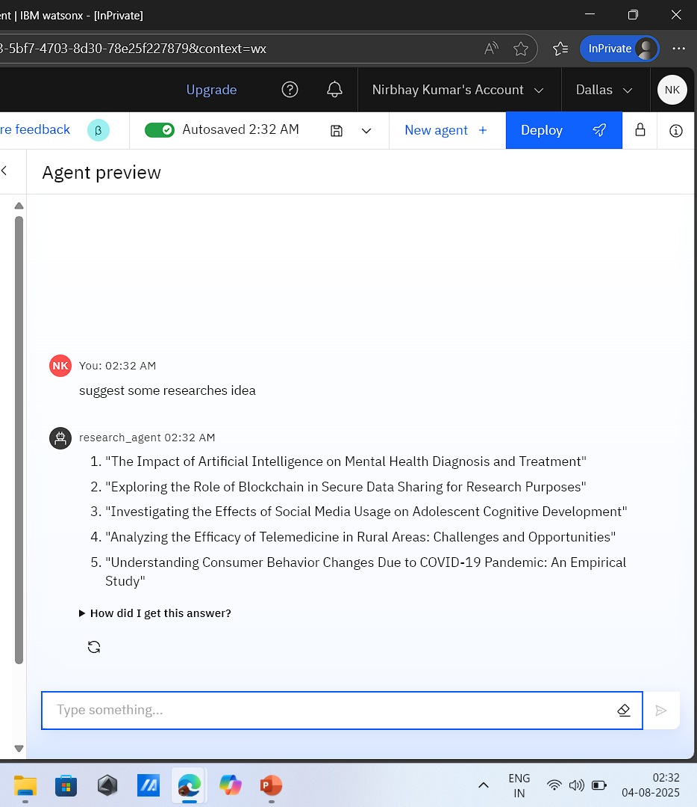
Results

Slide 10
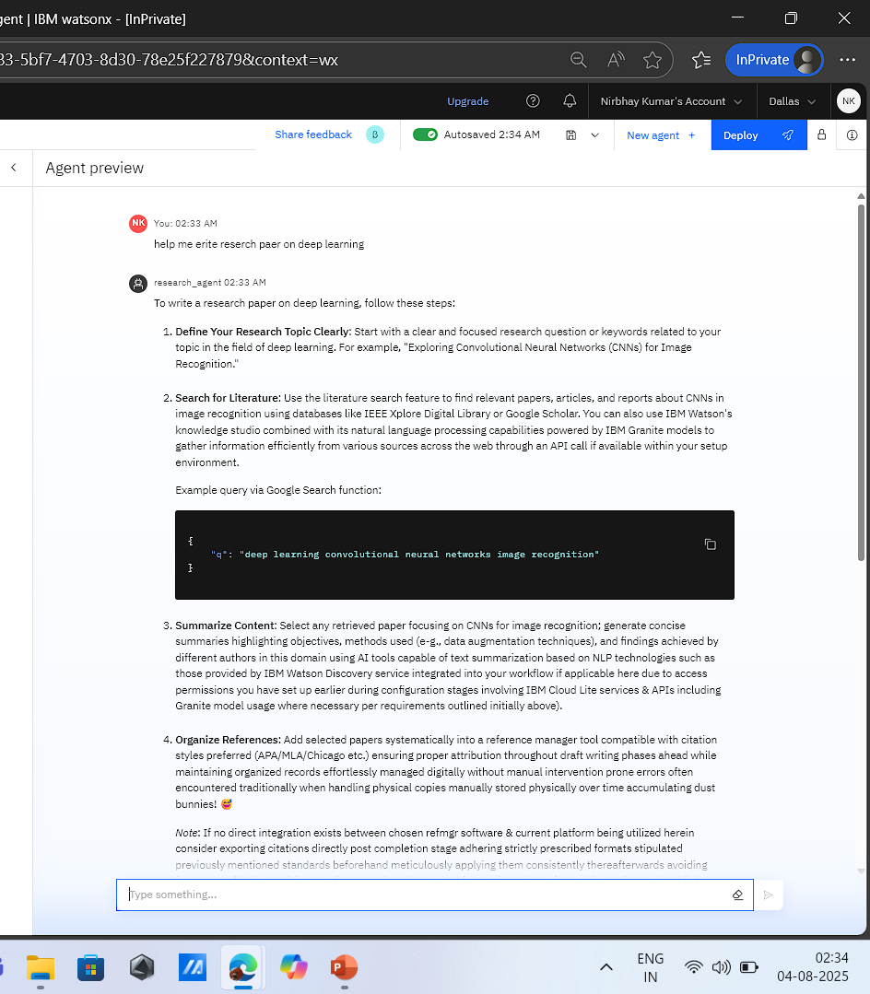
Results

Slide 11
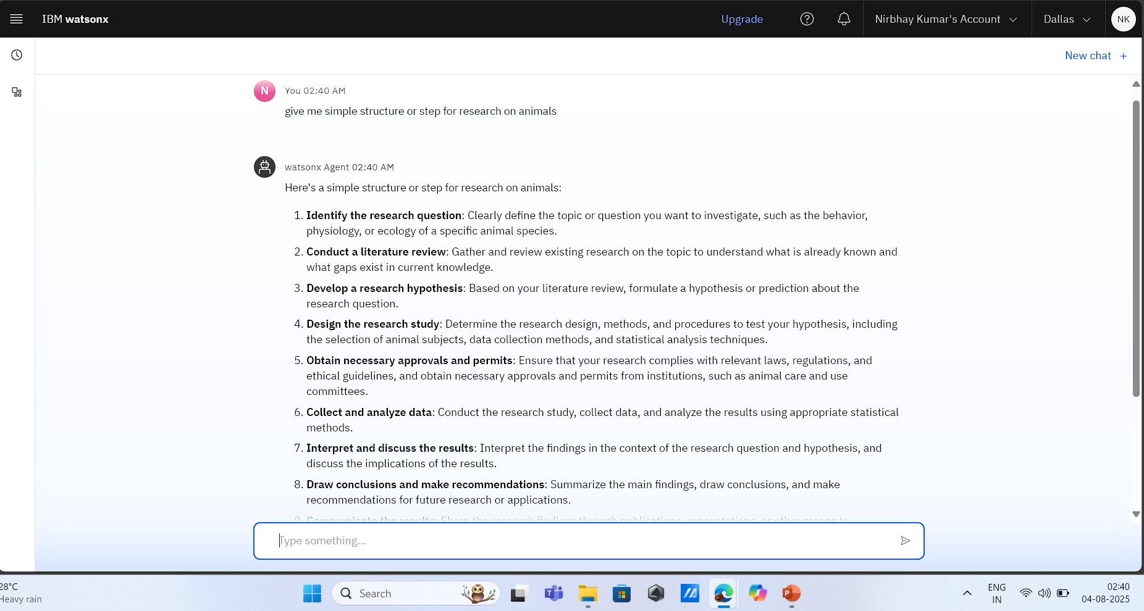
Results
Deployed AI Agent

Slide 12
Conclusion
The Research Agent simplifies the research process by intelligently guiding users from question formulation to result communication.
It reduces effort and improves precision by automating tasks like literature summarization, reference management, and paper drafting.
Research Agents empower researchers and institutions to innovate faster and collaborate more effectively in both academic and industrial domains.

Slide 13
Future scope
Multilingual Research Support
Voice-Activated Research Assistant
Real-Time Collaboration Features
Research Gap and Novel Topic Identification
Integration with Publishing Platforms
AI-Assisted Paper Drafting

Slide 14
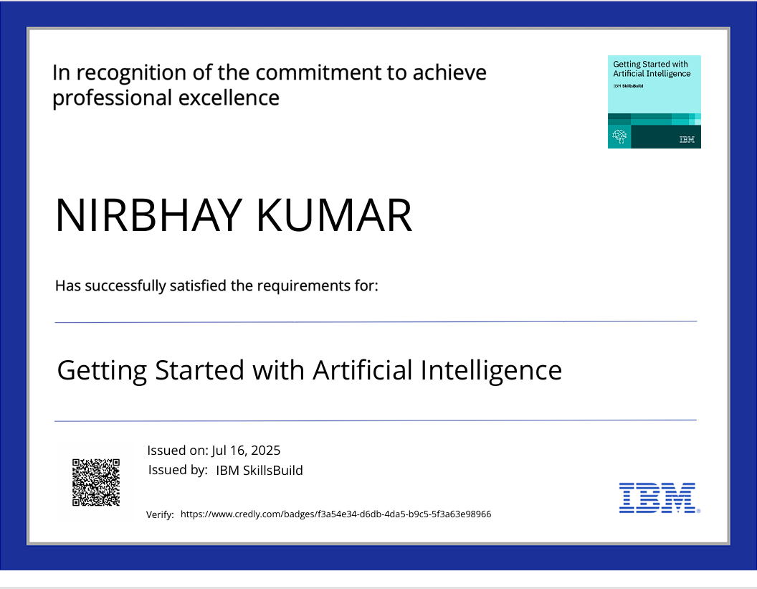
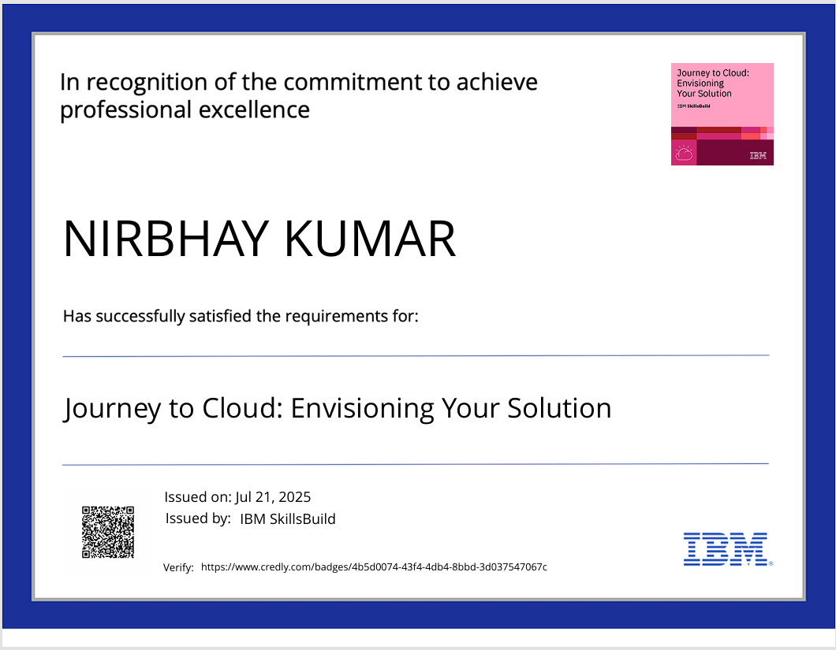
IBM Certifications

Slide 15
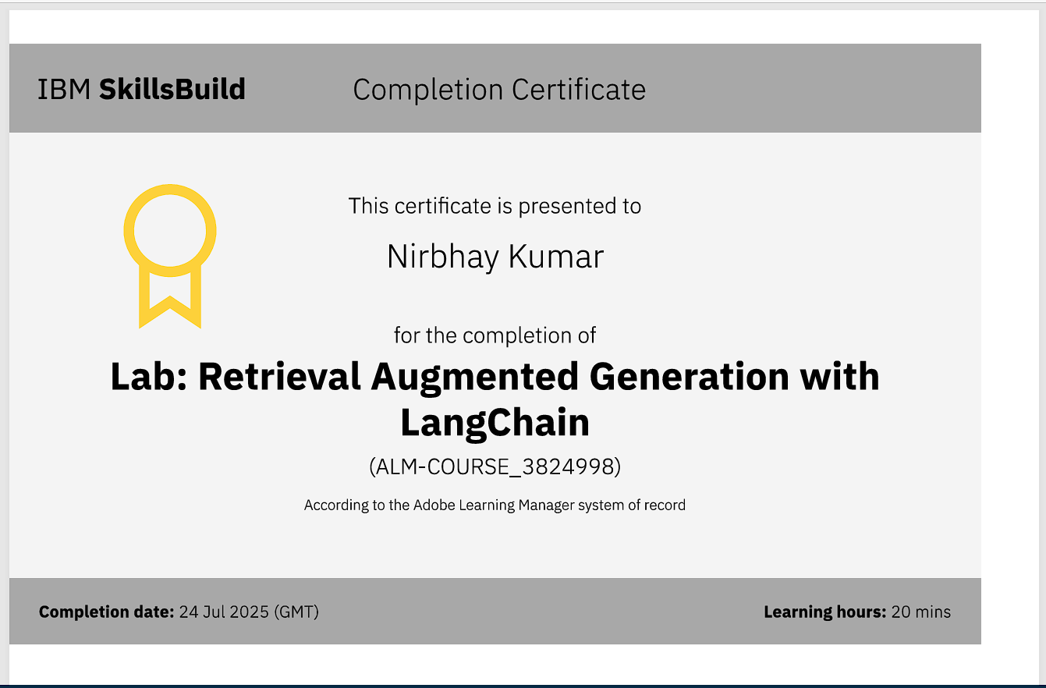

Slide 16
Git hub lik : https://github.com/nirbhayb10/Research-agent.git

Slide 17
GitHub Link
Make sure that there should be readme file

Slide 18
THANK YOU

